Slide 1




Analyze heart disease data with Power BI
Presented by Mariam Ahmed

Slide 2



Introduction to project
The goal of the project to analyze heart disease data to understand the influencing factors and provide insights that help predict the disease.
Tools used: Power BI + DAX
Data source: Heart Disease Dataset.
📊 Data overview:
The data contains information such as age, gender, blood pressure,
heart rate, cholesterol level, type of chest pain, and others.

Slide 3

Dataset Overview
age: Age of the patient (Integer)
sex: Gender of the patient (0 = Female, 1 = Male) (Integer)
cp: Type of Chest Pain (4 categories) (Integer: 0-3)
trestbps: Resting Blood Pressure (mmHg) (Numeric)
chol: Cholesterol Level (mg/dl) (Numeric)
fbs: Fasting Blood Sugar > 120 mg/dl? (0 = No, 1 = Yes) (Integer: 0/1)
restecg: Resting Electrocardiogram Results (Integer: 0-2)
thalach: Maximum Heart Rate Achieved (Numeric)
exang: Exercise-Induced Angina (0 = No, 1 = Yes) (Integer: 0/1)
oldpeak: ST Depression Induced by Exercise (Decimal)
slope: Slope of the Peak Exercise ST Segment (0 = Downsloping, 1 = Flat, 2 = Upsloping) (Integer: 0-2)
ca: Number of Major Vessels Colored by Fluoroscopy (Integer: 0-4)
thal: Thallium Stress Test Results (Integer: 0-3)
target: Presence of Heart Disease (0 = No, 1 = Yes) (Integer: 0/1)

Slide 4
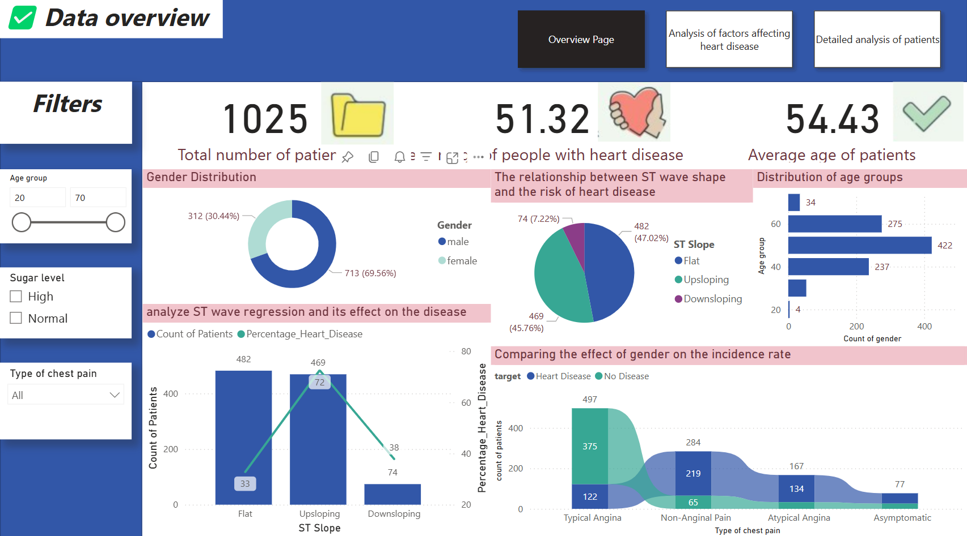

PatientOverview Dashboard

Slide 5

Content :
Total number of patients.
Percentage of people with heart disease.
Average age of patients.
Donut chart to illustrate gender distribution (male/female).
Bar chart showing the distribution of patients by age groups.
Pie chart showing The relationship between ST slop and risk of heart disease.
Line column chart showing analyze ST wave regression and its effect on the disease.
Ribbon Chart Comparing the effect of gender on the incidence rate
🎯 The question this page answers:
✅ How are age groups and gender distributed among patients?

Slide 6
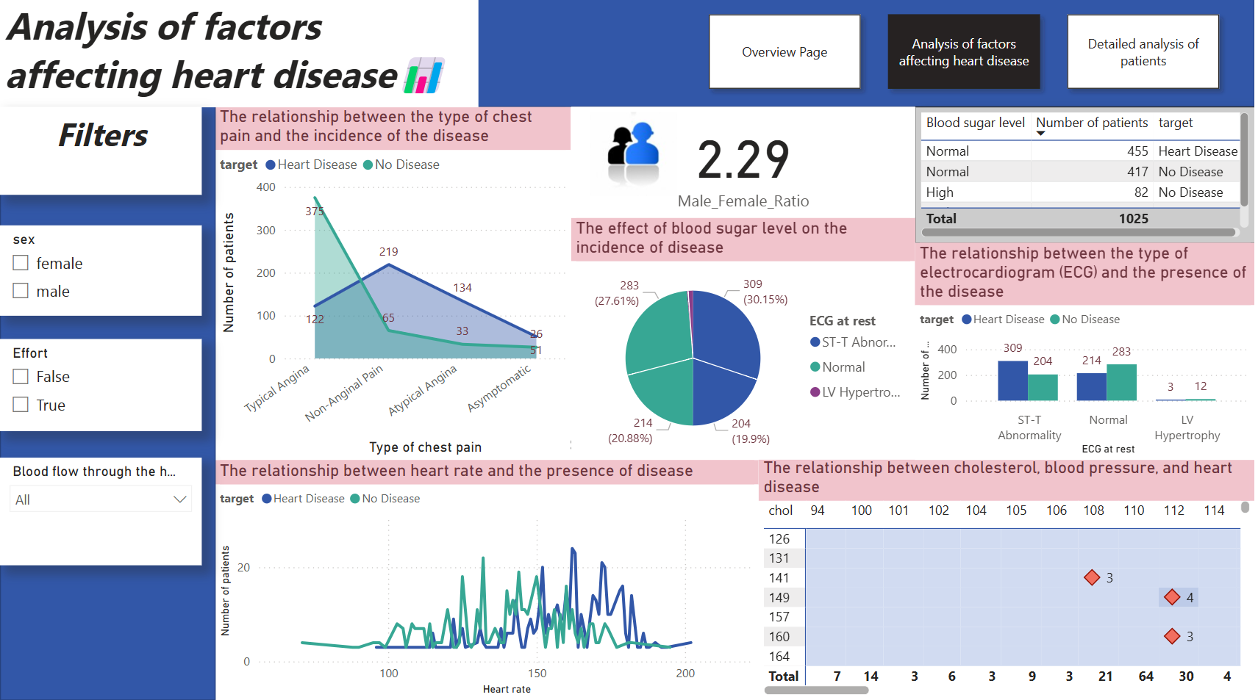
Analysis of factors affecting heart disease

Slide 7

Content:
Area chart showing Relationship between chest pain type and disease incidence
Pie chart showing Impact of blood sugar on disease occurrence
Column chart of ECG type and its link to disease presence
Line chart Heart rate correlation with disease
Heatmap showing Cholesterol, blood pressure, and heart disease connection
Card of Male-to-female ratio
🎯 The question this page answers:
✅ What factors are most closely linked to heart disease?

Slide 8
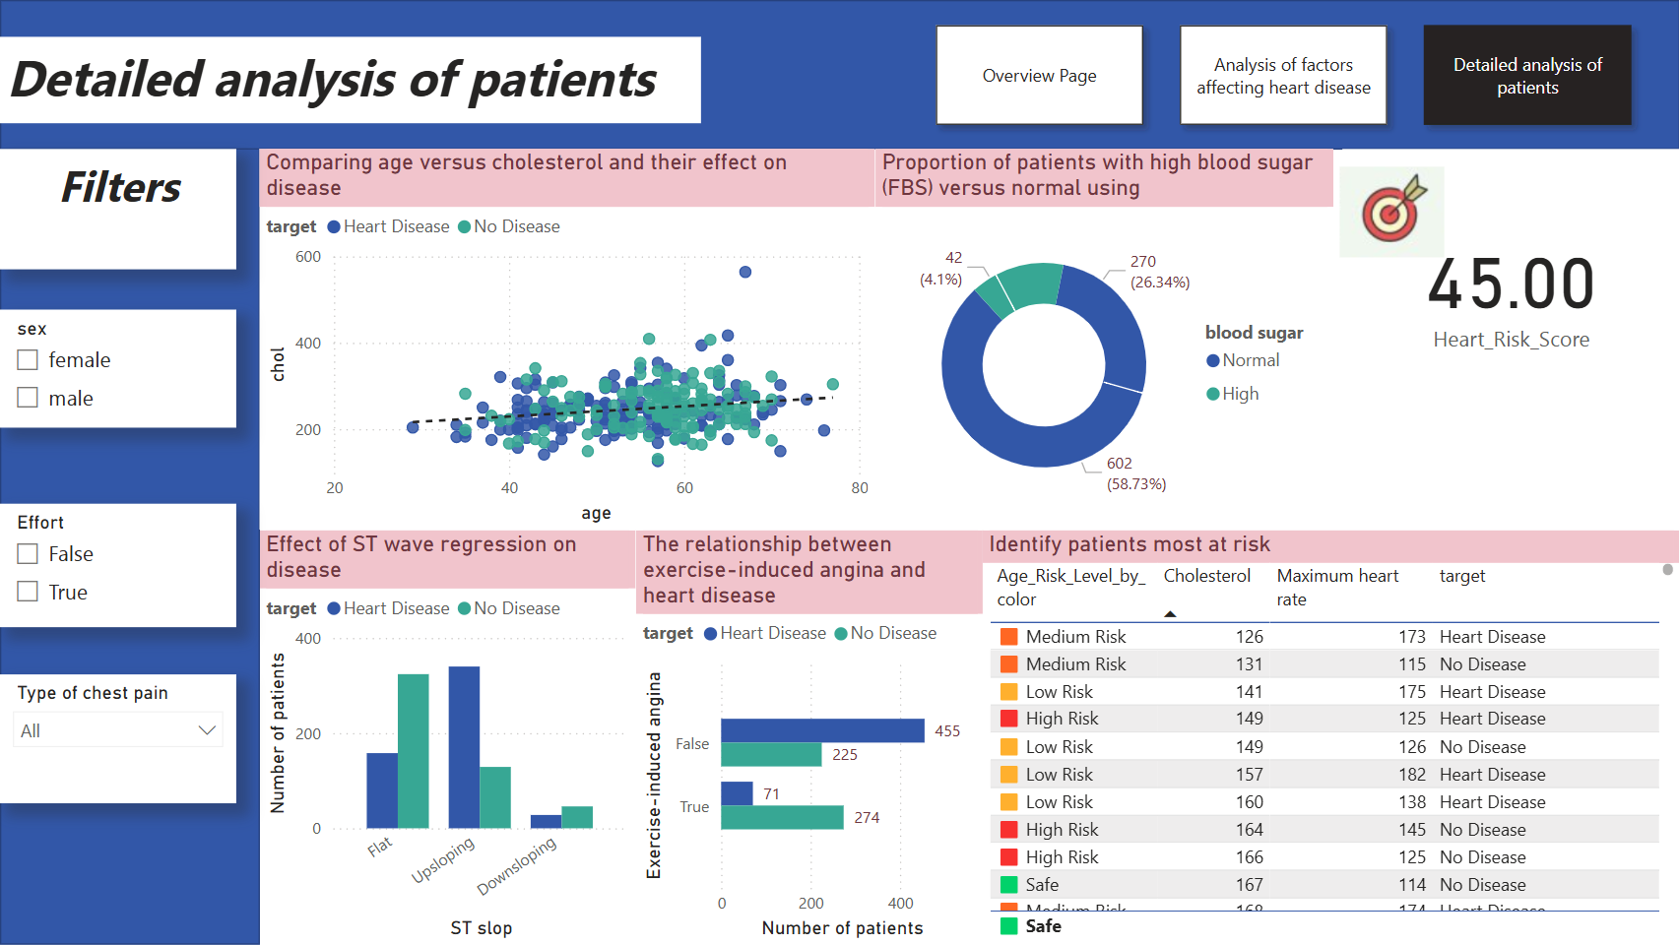

Detailed analysis of patients

Slide 9

Content:
Scatter chart showing Age vs. cholesterol impact on disease
Donut chart showing High vs. normal blood sugar proportion
Card of Heart Risk Score analysis
Column chart of ST wave regression effect on disease
Column chart of Exercise-induced angina and heart disease link
Table ofHigh-risk patient identification
🎯 The question this page answers:
✅ How are various medical factors distributed between infected and uninfected patients?

Slide 10

Conclusion & Recommendations
🔹The most important results extracted:
The strong relationship between the type of chest pain and the risk of infection.
High risk for patients with high cholesterol levels.
The effect of heart rate on the probability of contracting the disease.
🔹 Recommendations:
Use these analyzes to support doctors in early diagnosis.
Expanding the data by adding information about healthy habits such as smoking and physical activity.
Create artificial intelligence models to predict disease based on data.

Slide 11


Thank
You

